Slide 1
Introduction to Network
What is a Network ?
Network is a collection of devices connected to each other via media for the purpose of sharing resources. Example: Documents, Internet etc.
Advantages of network
- Communication is faster and easier.
- Cost effective.
What is networking
It is process of establishing a successful communication over an existing network.
What is protocol
It is rules and regulations which enable communication between devices in a network.

Slide 2
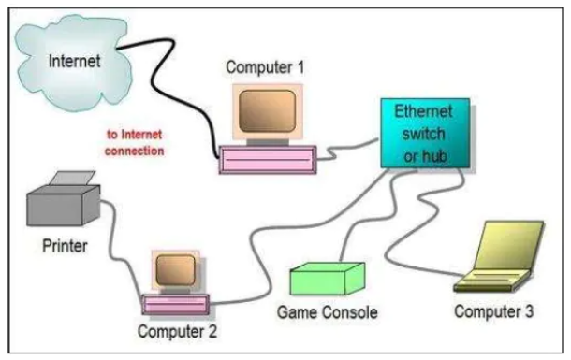
Types of Network
In order to build a network we have different types.
They are categorized as,
Based on trends
Wired
- It is the term refers to any physical medium
consisting of cables.
The cables can be copper wire, twisted
pair or fibre optic.
This connection is shared among multiple
devices using wired network concept.

Slide 3
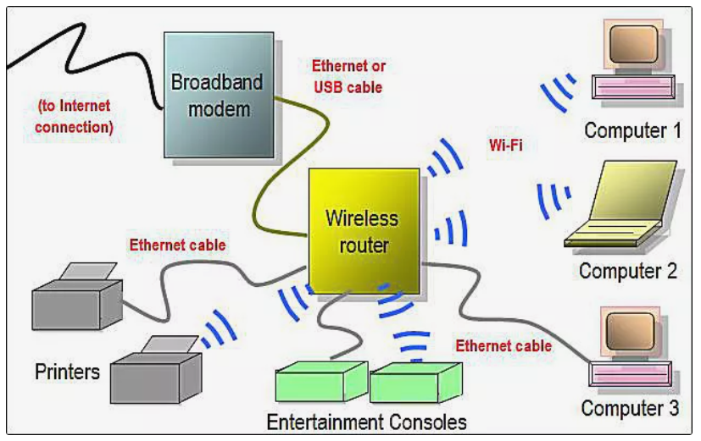
Wireless
- It is the term refers to medium made of electromagnetic waves (i.e. EM Waves) or infrared waves.
All the wireless devices will have antenna or sensors.
Typical wireless devices include cellular mobile, wireless sensors, TV remote, satellite disc receiver, and laptops with WLAN card etc.

Slide 4
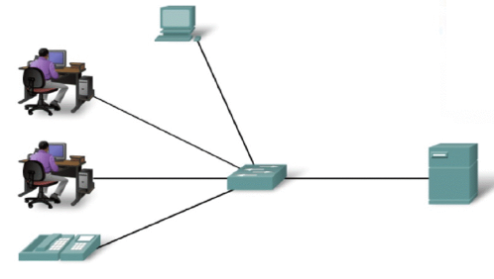
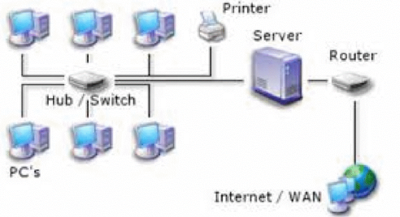
Based on Distance
local area network (LAN)
It is limited to a specific area, usually an office, and cannot extend beyond the boundaries of a single building.

Slide 5
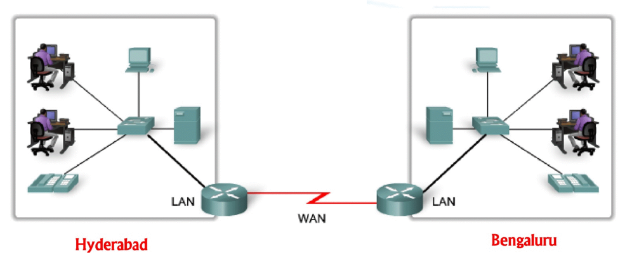
2. WAN (Wide Area Network):
A WAN is any network that crosses metropolitan, regional, or national boundaries.
Most networking professionals define a WAN as any network that uses
routers and public network links.

Slide 6
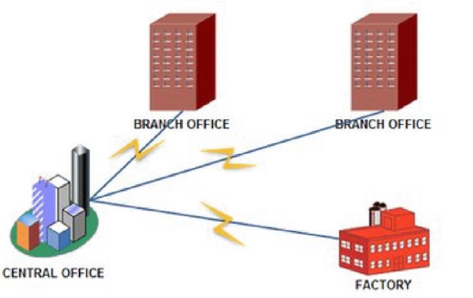
MAN (Metropolitan Area Network):
It refers to a network that exists within a single city or metropolitan If area.
We had two different buildings within a city that were connected together, it would be considered a MAN.

Slide 7
Based on Architecture
Client/Server (Domain Model):
- The server in a server-based network may provide a number of different services.
- The services it will offer to the network usually are decided by the server’s role.
- There are a number of different roles that a server could play on a network:
> File and print servers, Application servers, Web servers, Directory servers
Advantages of Client/Server:
Centralized: Locating, accessing, managing files is easier. Administrative burden
is reduced.
Scalability: Adding/removing of computers is easier and it does not affect the
architecture.
Flexibility: Integration of new technology can be implemented.
Disadvantages:
i. It is expensive.
ii. Required higher configuration hardware resources.
iii. If the server goes down communication path is lost.

Slide 8
Peer-to-Peer [Workgroup]
A peer-to-peer network has no dedicated servers; instead, a number of workstations are connected together for the purpose of sharing information or devices.
When there is no dedicated server, all workstations are considered equal; any one of them can participate as the client or the server.
Disadvantages of Peer-to-Peer
i. It is decentralized.
ii. Administrative burden is more.
iii. Locating and accessing of files is difficult.
Advantages of Peer-to-Peer
i. It is cost effective.
ii. Does not require higher configuration hardware resources

Slide 9
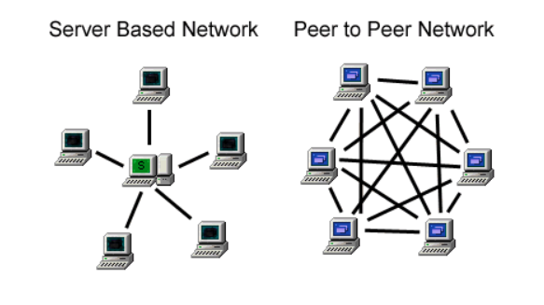

Slide 10
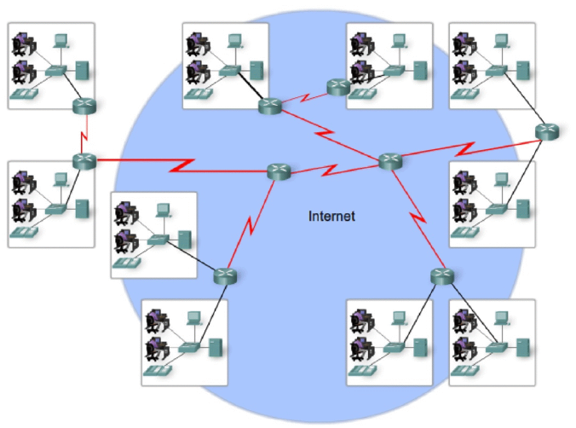
Based on Connection
Internet:
Internet is a global network that connects billions of
computers across the world with each other
It is believed that the internet was developed by
"Defense Advanced Projects Agency" (DARPA)
department of the United States.
And, it was first connected in 1969

Slide 11
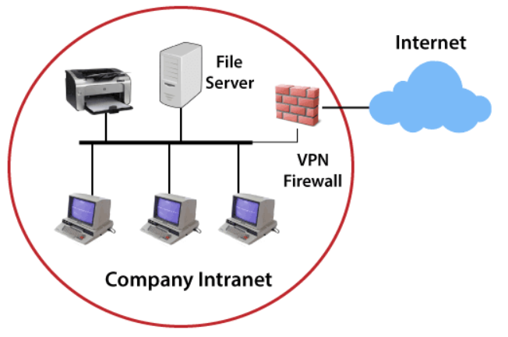
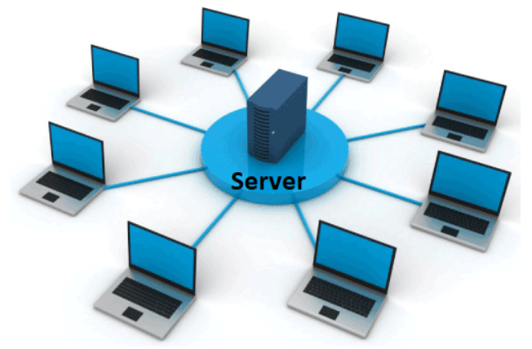
Intranet:
The intranet is a private network that belongs to a particular organization.
It is designed for the exclusive use of an organization and its associates, such as employees, customers, and other authorized people.
The information on a company’s intranet would not be accessible to persons on the Internet because it is not for public use.

Slide 12
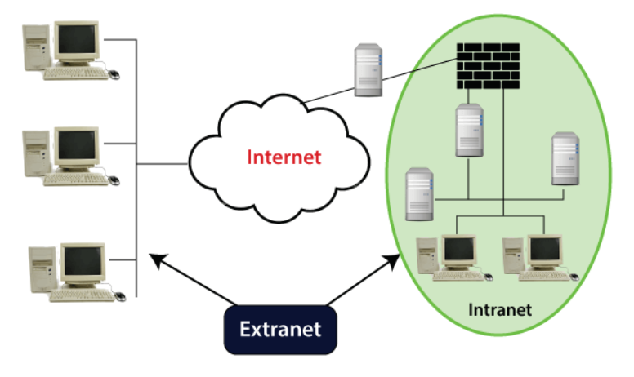
Extranet:
If one extends his/her intranet out to select business partners or customers, they have created an extranet.
An extranet cannot be used by anyone else external to the company except for those selected individuals.

Slide 13
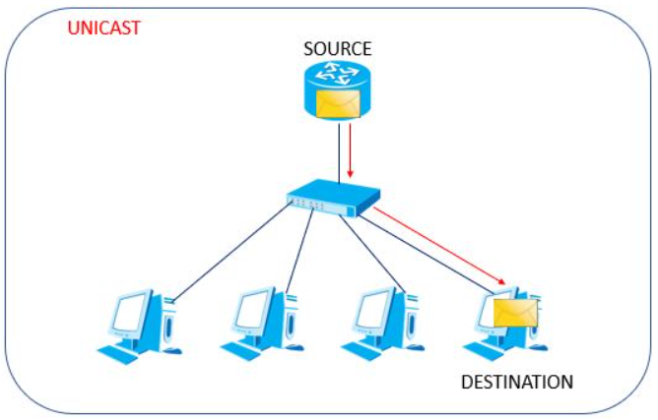
Types of communication
1. Unicast –
This type of information transfer is useful when there is a participation of single sender and single recipient.
So, in short you can term it as a one-to- one transmission.

Slide 14
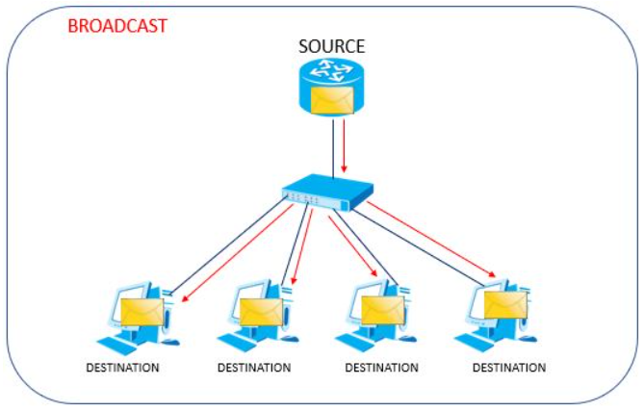
2. Broadcast –
This type of information transfer is useful when there is a participation of single sender and all recipient.
So, in short you can term it as a one-to- all transmission.

Slide 15
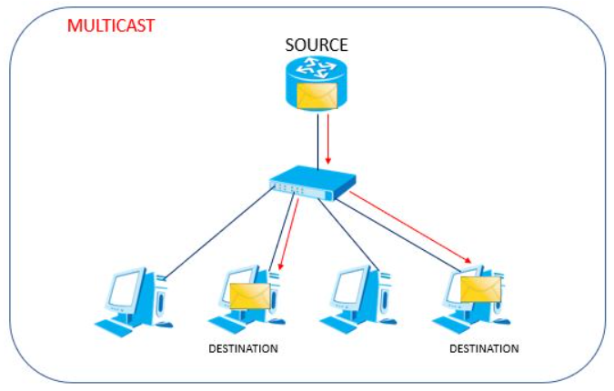
3. Multicast –
- In multicasting, one/more senders and one/more recipients participate in data transfer traffic.
So, in short you can term it as a one-to- group or selected transmission.

Slide 16
Components required for establishing network
End devices with NIC and NOS
Media
Networking devices
Protocol

